Slide 2
STEM FUNDAMENTAL
SESSION NO: 2
TOPIC OF THE DAY: Reflection – Concave & Convex.
LEARNING TARGET: Reflection of Light.

Slide 3
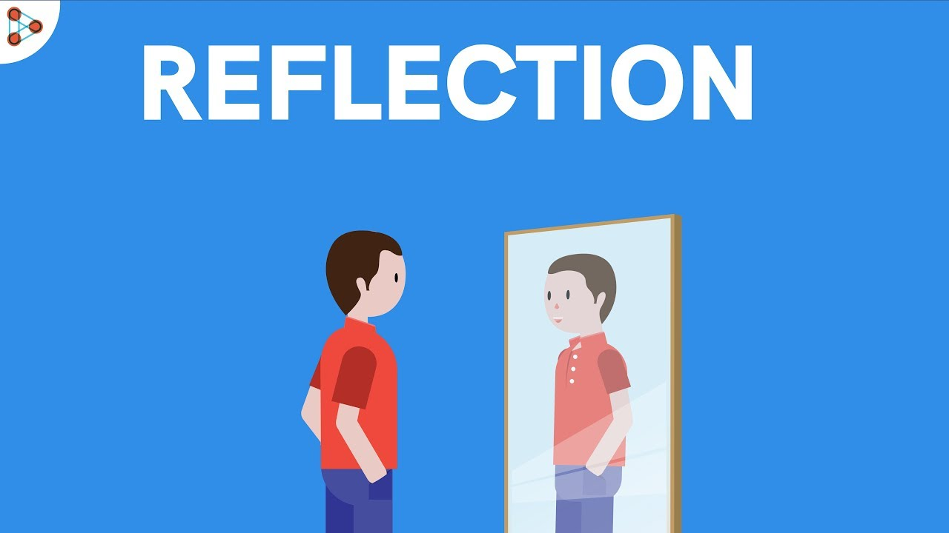
Reflection Of Light

Slide 4
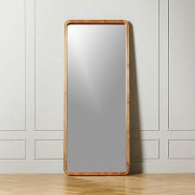
What Do You See When You Stand In Front Of The Mirror ?

Slide 5
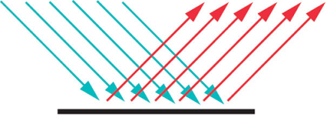
What Is Reflection Of Light?
Reflection is when light bounces off an object

Slide 6

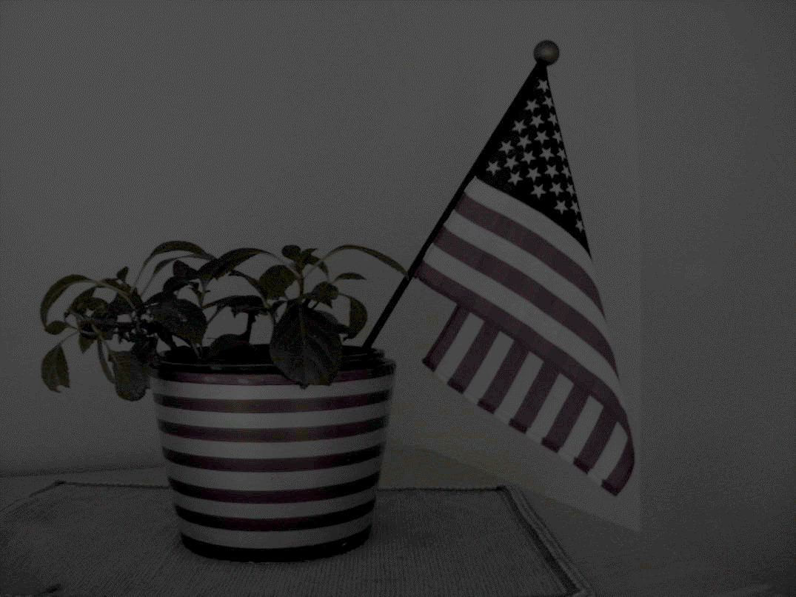
Can You See Anything?
Presence Of Light
Absence Of Light

Slide 7
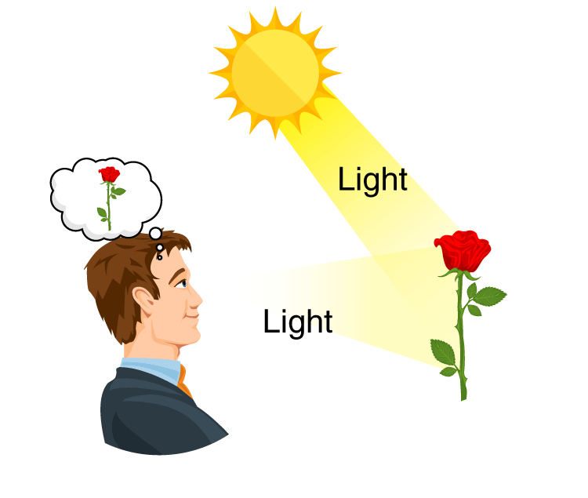
How We Can See Things Around Us

Slide 8
Common Types Of Mirrors
Plane Mirror — These are flat mirrors that reflect images in their normal proportions
Concave Mirror — Concave mirrors are spherical mirrors that curve inward like a spoon
Convex Mirror — Convex mirrors are also spherical mirrors.

Slide 9
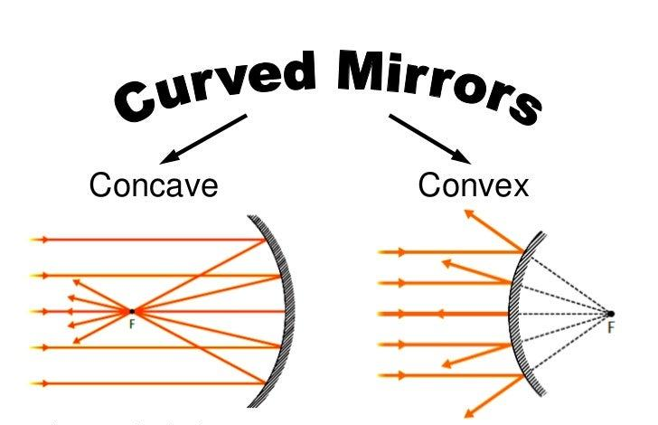

Slide 10
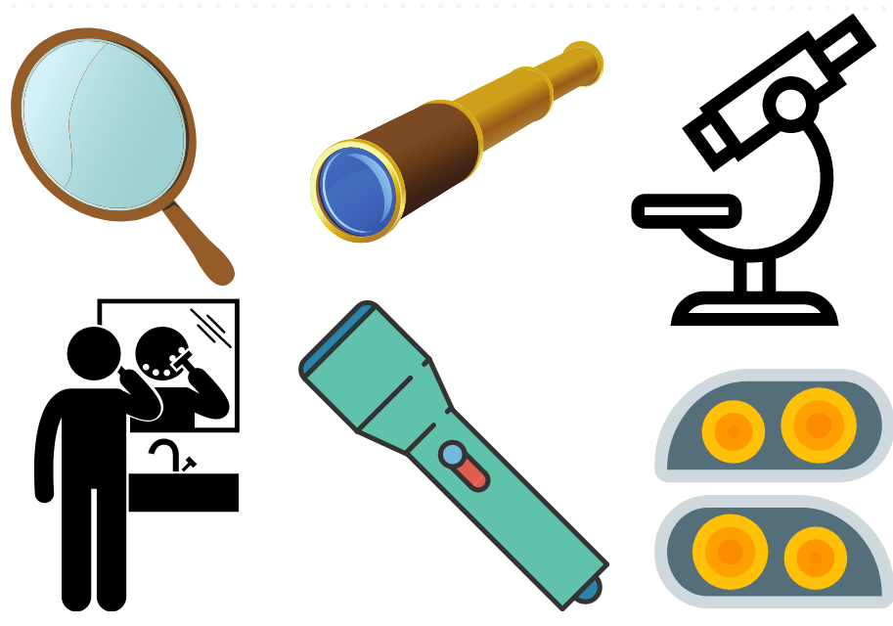
Use of Concave mirror
Dental mirrors
Satellite dishes
Headlights
Astronomical telescope/’’’

Slide 11
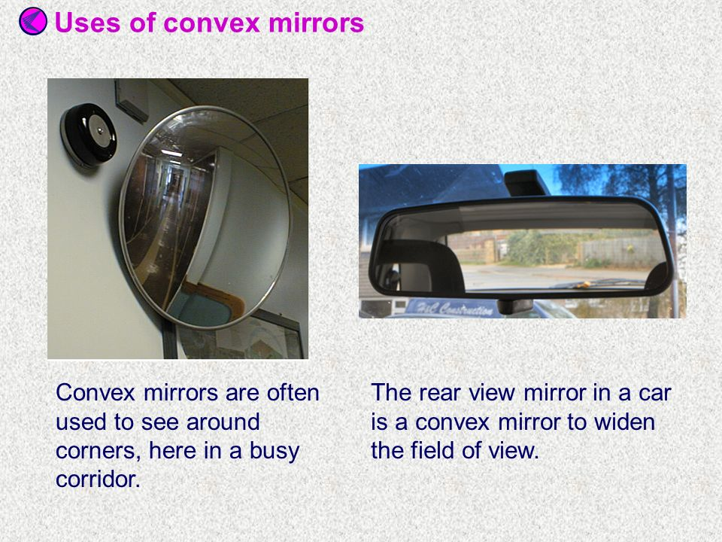
Use of Convex Mirror
Rear-view mirrors in automobiles
Security mirrors

